Slide 1
BOOLEAN FUNCTIONS - MOISIL’S SIMPLIFICATION METHOD
FILIP CRISAN, GROUP 912

Slide 2
PROBLEM STATEMENT (EXERCISE 8.2)
Using Moisil’s method simplify the following Boolean function of 3 variables:
f(x1, x2, x3) = m0 v m1 v m3 v m4 v m7

Slide 3
THEORETICAL RESULTS
In order to perform the Moisil’s simplification method, follow these steps:
1. Transform the initial Boolean function into its equivalent disjunctive canonical form
2. Calculate the set of maximal monoms using Veitch-Karnaugh diagrams method or Quine’s method
3. Use propositional logic to obtain the simplified forms from the set of maximal monoms

Slide 4
DETERMINE THE DCF
STEP 1
f(x1, x2, x3) = m0 v m1 v m3 v m4 v m7
Because f is equal to the disjunction of these minterms, we already have the DCF

Slide 5
CALCULATE THE SET OF MAXIMAL MONOMS
STEP 2 (I)
We will use Quine’s method to achieve this
f(x1, x2, x3) = m0 ∨ m1 ∨ m3 ∨ m4 ∨ m7 = (x1 ∧ x2 ∧ x3) ∨ (x1 ∧ x2 ∧ x3) ∨ (x1 ∧ x2 ∧ x3) ∨ (x1 ∧ x2 ∧ x3) ∨ (x1 ∧ x2 ∧ x3)
From the above form, we can determine the support of f, which is the set of values for which the Boolean function is equal to ‘1’:
Sf = {(0, 0, 0), (0, 0, 1), (0, 1, 1), (1, 0, 0), (1, 1, 1)}

Slide 6
STEP 2 (II)
Now we have to sort the support set of f in ascending/descending order, by the number of ‘1’ values in each triple
Sf = {(0, 0, 0), (0, 0, 1), (0, 1, 1), (1, 0, 0), (1, 1, 1)}
Sf = {(0, 0, 0), (0, 0, 1), (1, 0, 0), (0, 1, 1), (1, 1, 1)}
Based on this, we will create a table in which we will form groups of minterms, such that every member of a group will have the same number of ‘1’ values as the others. The process that follows is called factorisation.
ascending order

Slide 7
STEP 2 (III) FACTORISATION PROCESS
Group | x1 | x2 | x3
I | 0 | 0 | 0 | m0
II | 0 | 0 | 1 | m1
 | 1 | 0 | 0 | m4
III | 0 | 1 | 1 | m3
IV | 1 | 1 | 1 | m7
V = I + II | 0 | 0 | — | m0 ∨ m1 = x1x2 = max1
 | — | 0 | 0 | m0 ∨ m4 = x2x3 = max2
VI = II + III | 0 | — | 1 | m1 ∨ m3 = x1x3 = max3
VII = III + IV | — | 1 | 1 | m3 ∨ m7 = x2x3 = max4

Slide 8
STEP 2 (IV)
From the above table, we now have the maximal monoms:
M(f) = {x1x2, x2x3, x1x3, x2x3} = {max1, max2, max3, max4}

Slide 9
PROPOSITIONAL LOGIC PART
STEP 3 (I)
In the factorisation process described earlier, we performed 4 simple factorisations:
max1 = x1x2 = m0 ∨ m1
max2 = x2x3 = m0 ∨ m4
max3 = x1x3 = m1 ∨ m3
max4 = x2x3 = m3 ∨ m7

Slide 10
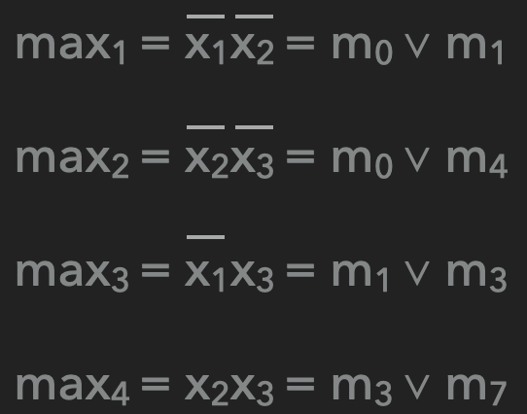
STEP 3 (II)
Each minterm from the function’s expression must be covered by a maximal monom in a simplified form, therefore according to the result of the factorisation process we have the following true sentences:
pi means: “maxi belongs to a simplified form”, i ∈ {1, 2, 3, 4}
“m0 is covered by max1 or by max2”, which is translated to: p1 ∨ p2 ≡ T
“m1 is covered by max1 or by max3”, which is translated to: p1 ∨ p3 ≡ T
“m3 is covered by max3 or by max4”, which is translated to: p3 ∨ p4 ≡ T
“m4 is covered by max2”, which is translated to: p2 ≡ T
“m7 is covered by max4”, which is translated to: p4 ≡ T

Slide 11
STEP 3 (III)
All the minterms from the function’s expression must be covered by a minimum number of maximal monoms, with a minimum number of overlaps. This statement is modelled by the following propositional formula obtained as a conjunction of all previous true sentences:
(p1 ∨ p2) ∧ (p1 ∨ p3) ∧ (p3 ∨ p4) ∧ p2 ∧ p4 ≡ T (CNF with 5 clauses)
We have to transform this CNF into a DNF

Slide 12
STEP 3 (IV)
Apply absorption law:
T ≡ (p1 ∨ p2) ∧ (p1 ∨ p3) ∧ (p3 ∨ p4) ∧ p2 ∧ p4 ≡ p2 ∧ (p1∨ p3) ∧ p4
Apply commutativity and distributivity law:
T ≡ p2 ∧ p4 ∧ (p1∨ p3) ≡ (p2 ∧ p4 ∧ p1) ∨ (p2 ∧ p4 ∧ p3)
In the previous line we’ve obtained a DNF with 2 cubes, which is true if at least one cube is true

Slide 13
STEP 3 (V)
From this DNF we consider the cubes with the minimum number of propositional variables and correspondingly we obtain the simplified forms of f. In this case, the only 2 cubes of our DNF have the same number of propositional values, so we have:
T ≡ (p2 ∧ p4 ∧ p1) ∨ (p2 ∧ p4 ∧ p3) (the DNF)
For the cube p2 ∧ p4 ∧ p1 ≡ T the corresponding simplified form is:
f1^{S} (x1, x2, x3) = max2 ∨ max4 ∨ max1 = x2x3 ∨ x2x3 ∨ x1x2
For the cube p2 ∧ p4 ∧ p3 ≡ T the corresponding simplified form is:
f2^{S} (x1, x2, x3) = max2 ∨ max4 ∨ max3 = x2x3 ∨ x2x3 ∨ x1x3

